Slide 1
Contract Review
Software Quality Assurance

Slide 2
Contract Review
Contract review is the software quality element that reduces the probability of such undesirable situations.
Contract review is a requirement by the ISO 9001 standard and ISO 9000- 3 Guidelines.

Slide 3
The contract review process and its stages
Several situations can lead a software company (“the supplier”) to sign a contract with a customer.
The most common are :
1. Participation in a tender.
2. Submission of a proposal according to the customer’s RFP.
3. Receipt of an order from a company’s customer
4. Receipt of an internal request or order from another department in the organization.

Slide 4
The Review Process
The review process itself is conducted in two stages :
Stage One – Review of the proposal draft prior to submission to the potential customer (“proposal draft review”).
Stage Two – Review of contract draft prior to signing (“contract draft review”).

Slide 5
Stage One
PROPOSAL DRAFT REVIEW

Slide 6
Proposal Draft review objectives
The objective of the proposal draft review is to make sure that the following activities have been satisfactorily carried out:
1. Customer requirements have been clarified and documented.
2. Alternative approaches for carrying out the project have been examined.
3. Formal aspects of the relationship between the customer and the software firm have been specified.
4. Identification of developments risks.
5. Adequate estimation of projects resources and timetable have been prepared.
6. Examination of the firm’s capacity with respect to the project.
7. Examination of the customer’s capacity to fulfill his commitments.
8. Definition of partner and subcontractor participation conditions.
9. Definition and protection of proprietary rights.

Slide 7
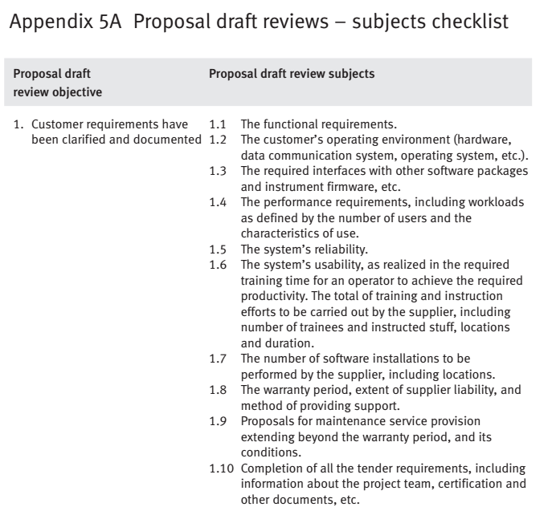
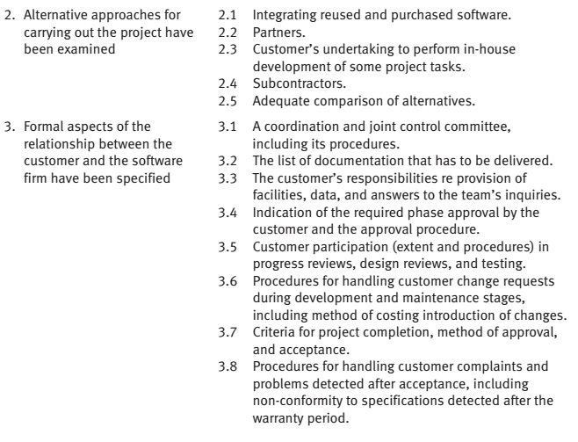
Proposal Draft review – Subject checklist

Slide 8
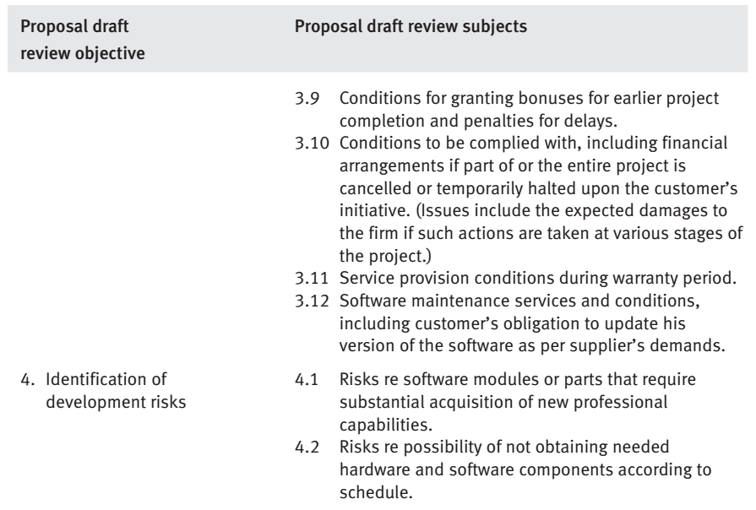
Proposal Draft review – Subject checklist

Slide 9
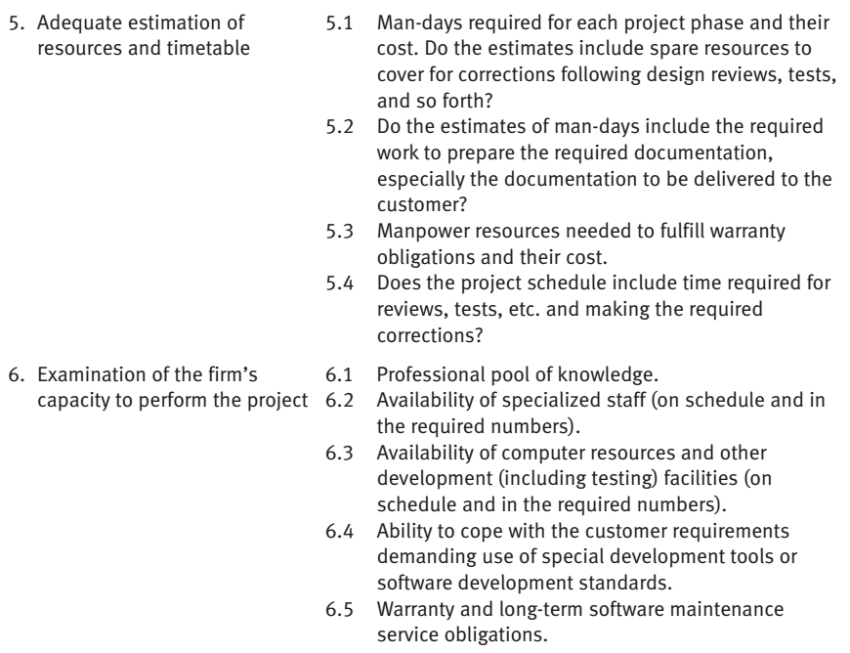
Proposal Draft review – Subject checklist

Slide 10
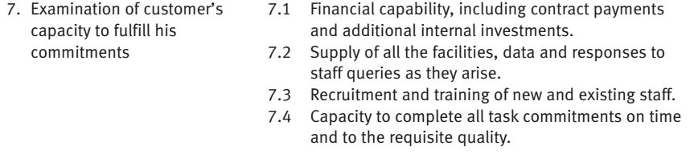
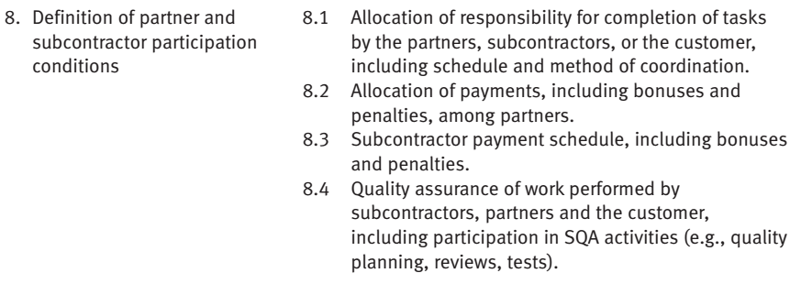
Proposal Draft review – Subject checklist

Slide 11
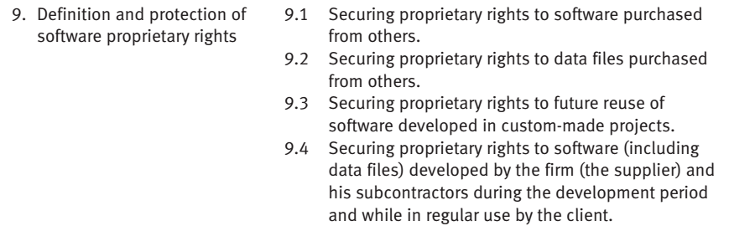
Proposal Draft review – Subject checklist

Slide 12
Stage Two
CONTRACT DRAFT REVIEW

Slide 13
Contract Draft Review Objectives
The objective of the contract draft review are to make sure that the following activities have been performed satisfactorily
1. No unclarified issues remain in the contract draft.
2. All understanding a reached subsequent to the proposal are correctly documented.
3. No “new” changes, additions, or omissions have entered the contract draft.

Slide 14
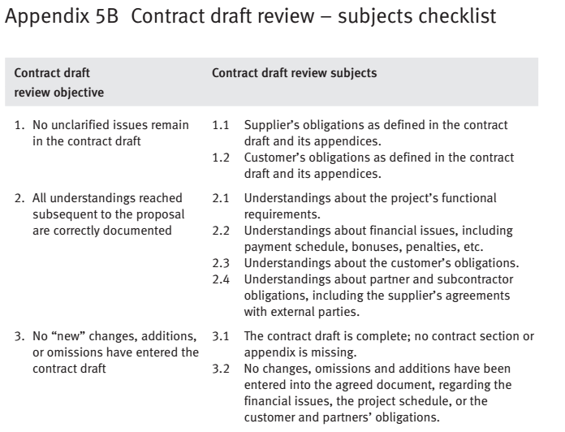
Contract Draft review – Subject checklist

Slide 15
Implementation of a contract review

Slide 16
Implementation of a contract review
Contract reviews vary in their magnitude, depending on the characteristics of the proposed project.
Factors affecting the extent of a contract review
Project magnitude
Project technical complexity
Degree of all staff acquaintance with and experience in the project area
Project organizational complexity
Who performs a contract review ?
The leader or another member of the proposal team
The members of the proposal team
An outside professional or a company staff member who is not a member of the proposal team
A team of outside experts.

Slide 17
Factors affecting the extent of a contract review:
9
 Project magnitude, usually measured in man- month resources.
 Project technical complexity
 Degree of staff acquaintance with and experience in the project area.
 Project organizational complexity, the greater the number of organizations ( partners, subcontractors, and customers ) taking part in the project, the greater the contract review efforts required.

Slide 18
Who performs a contract review:
10
 The leader or another member of the proposal team
 The members of the proposal team
 An outside professional or a company staff member who is not a member of the proposal team.
 A team of outside experts.

Slide 19
Implementation of a contract review of a major proposal
11
 The characteristics of the major proposal :
 Very large-scale project
 Very high technical complexity
 New professional area for the company
 High organizational complexity

Slide 20
Implementation of a contract review for a major proposal
Implementation of a contract review process for a major project usually involves substantial organizational difficulties.
The difficulties of carrying out contract reviews for major proposals
Time pressures.
Proper contract review requires substantial professionals work.
The potential contract review team members are very busy.

Slide 21
Implementation of a contract review of a
12
major proposal
 Recommended avenues ( approaches ) for implementing major contract reviews :
 The contract review should be scheduled.
 A team should carry out the contract review
 A contract team leader should be appointed
 The activities of the team leader include :
 Recruitment of the team members
 Distribution of review tasks
 Coordination between members
 Coordination between the review team and the proposal team
 Follow-up of activities, especially compliance with the schedule
 Summarization of the findings and their delivery to the proposal team.

Slide 22
Contract Review Subjects
Contract Reviews examine many subjects, based on the contract review objectives.
Checklist are useful devices for helping review teams to organize their work and achieve high coverage of the relevant subjects.

Slide 23
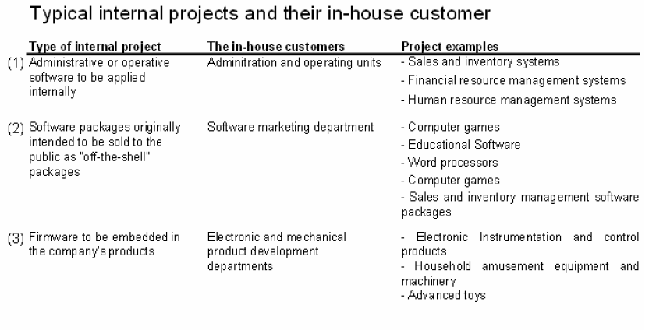
Contract Reviews for Internal Projects

Slide 24
Summary
1. Explain the two contract review stages
Proposal draft review
Contract draft review
2. List the objectives of contract review
3. Identify the factors that affect the extent of the contract review
4. Identify the difficulties in performing a major contract review
5. Explain the recommended avenues for implementing a major contract review
6. Discuss the importance of carrying out a contract review for internal projects

Slide 25
Reference:
Galin, SQA from Theory to Implementation @Pearson Education Limited 2004

